Slide 1

The Museum Berlin-Karlshorst – Comemorating History and Soviet heritage
Dr. Jörg Morré, Museum Berlin-Karlshorst, Germany

Slide 2
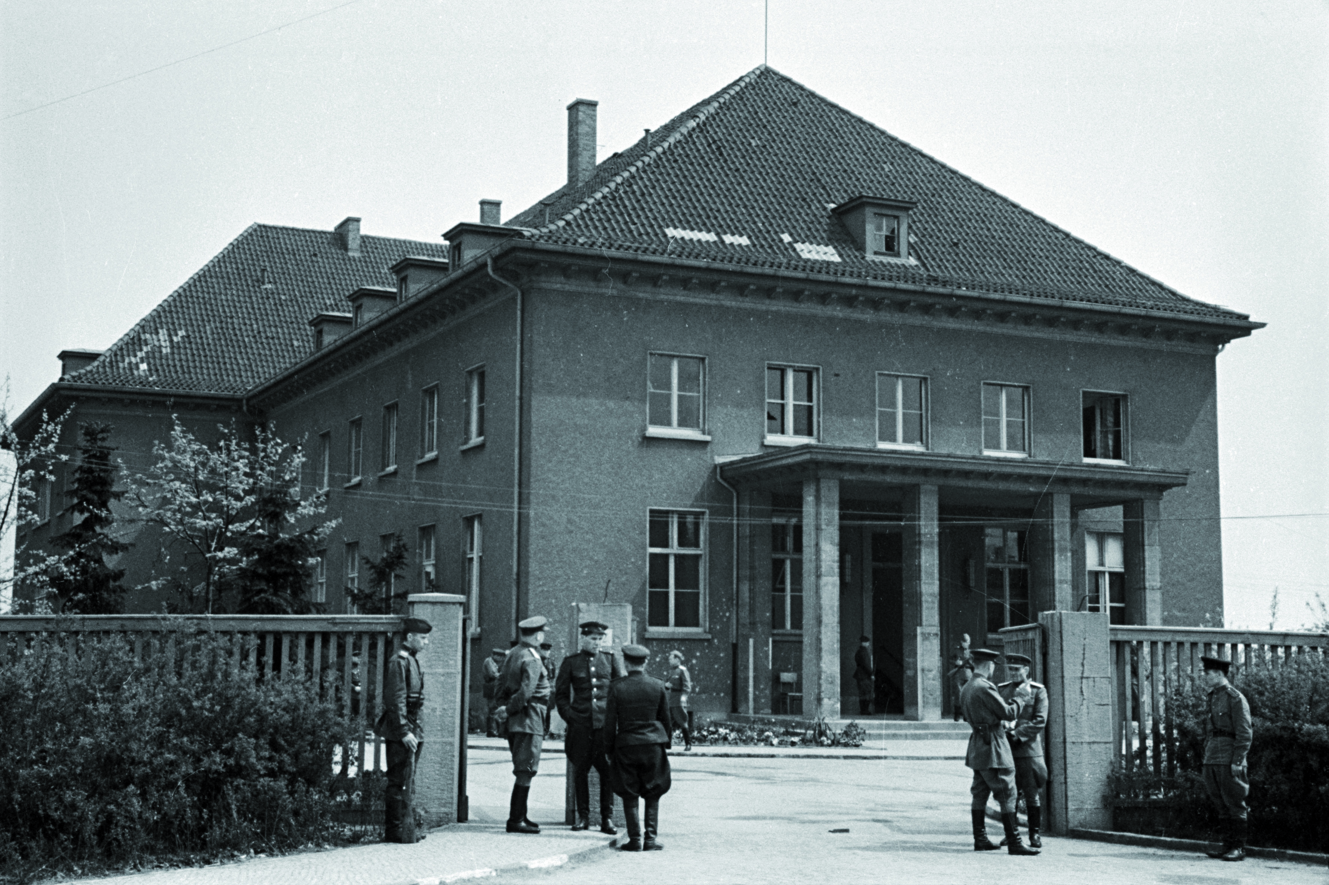
8th of May 1945. Act of Unconditional Surrender in front of the Soviet Supreme Headquarter in Berlin-Karlshorst

Slide 3
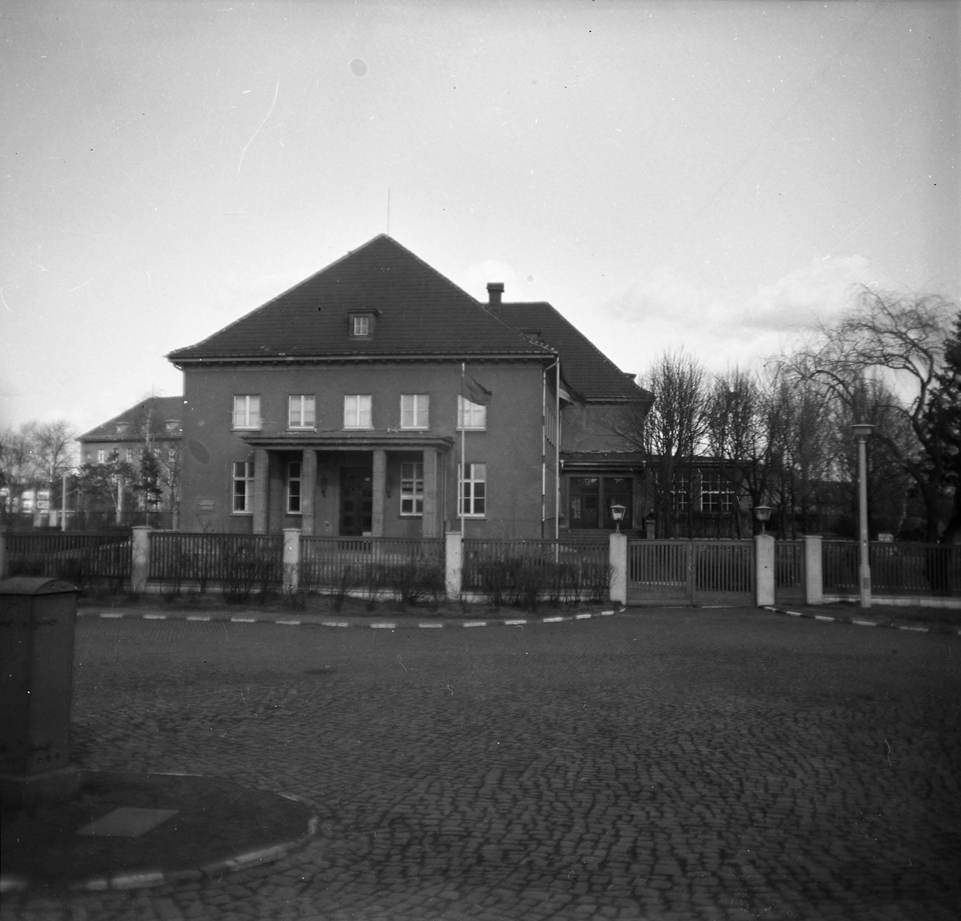
Residence of the Chief of the Soviet Military Adminstration / City Commander of Berlin, 1945 – 1962

Slide 4
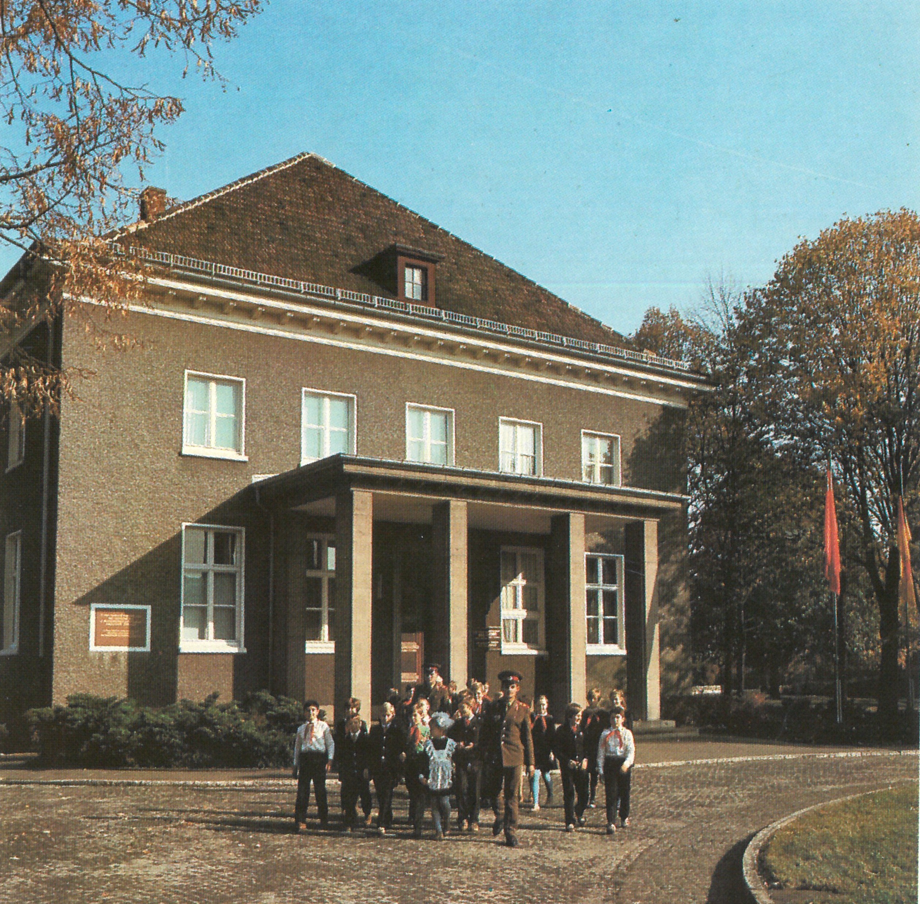
1967 – 1994 Soviet Military „Museum of the Unconditional Surrender“

Slide 5
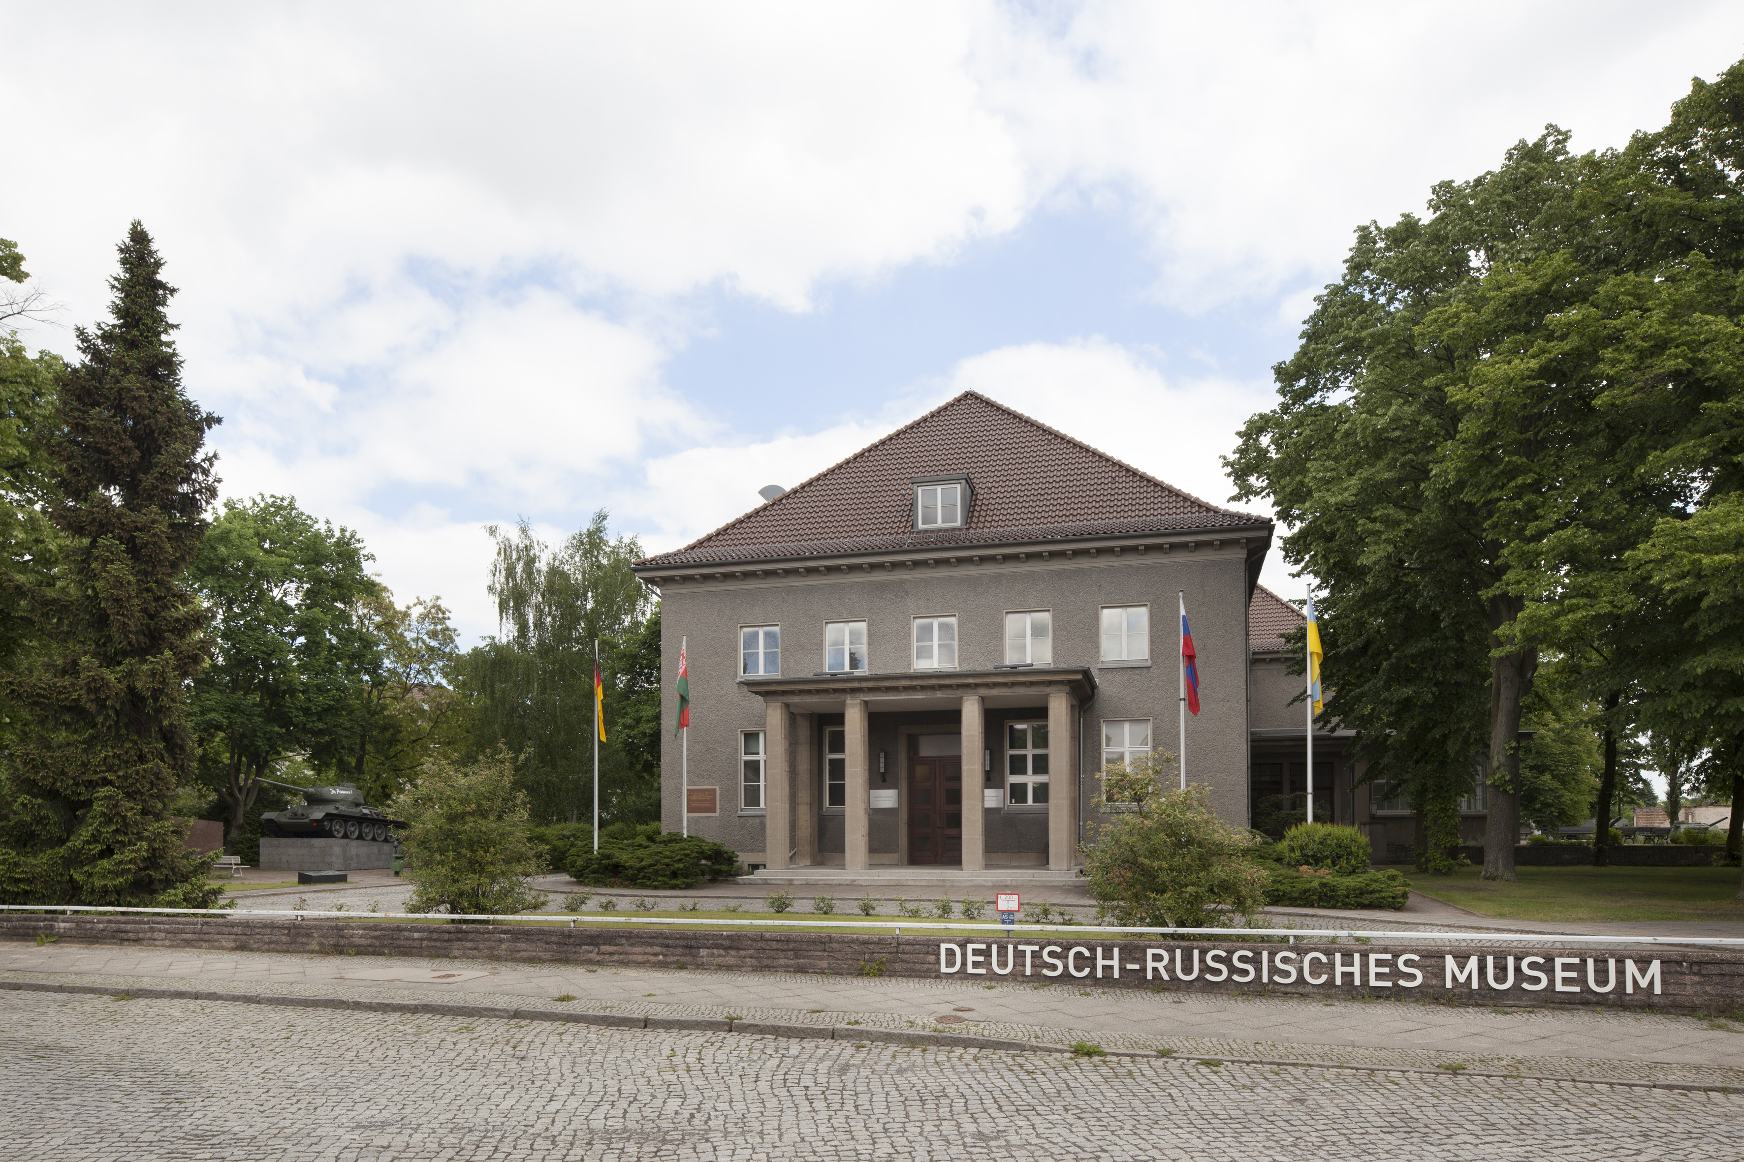
1994 – 2022 German-Russian Museum

Slide 6
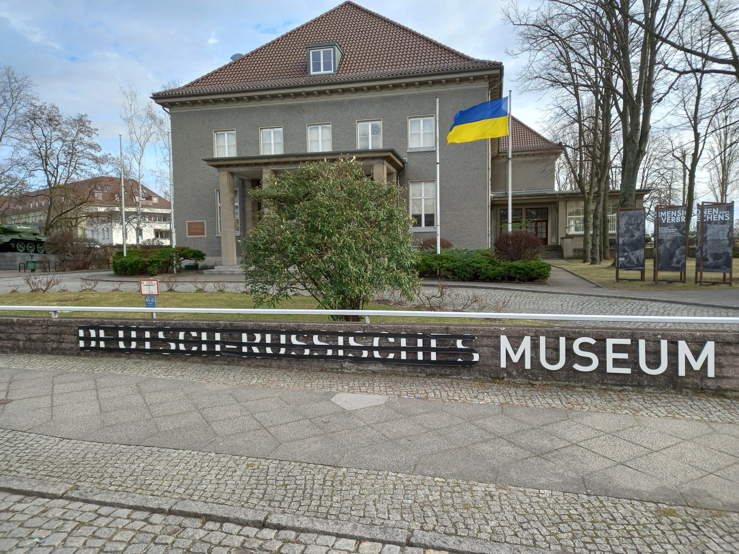
Statement 24th of February 2022 (first day of the war)

Slide 7
Place of an historical moment

Slide 8
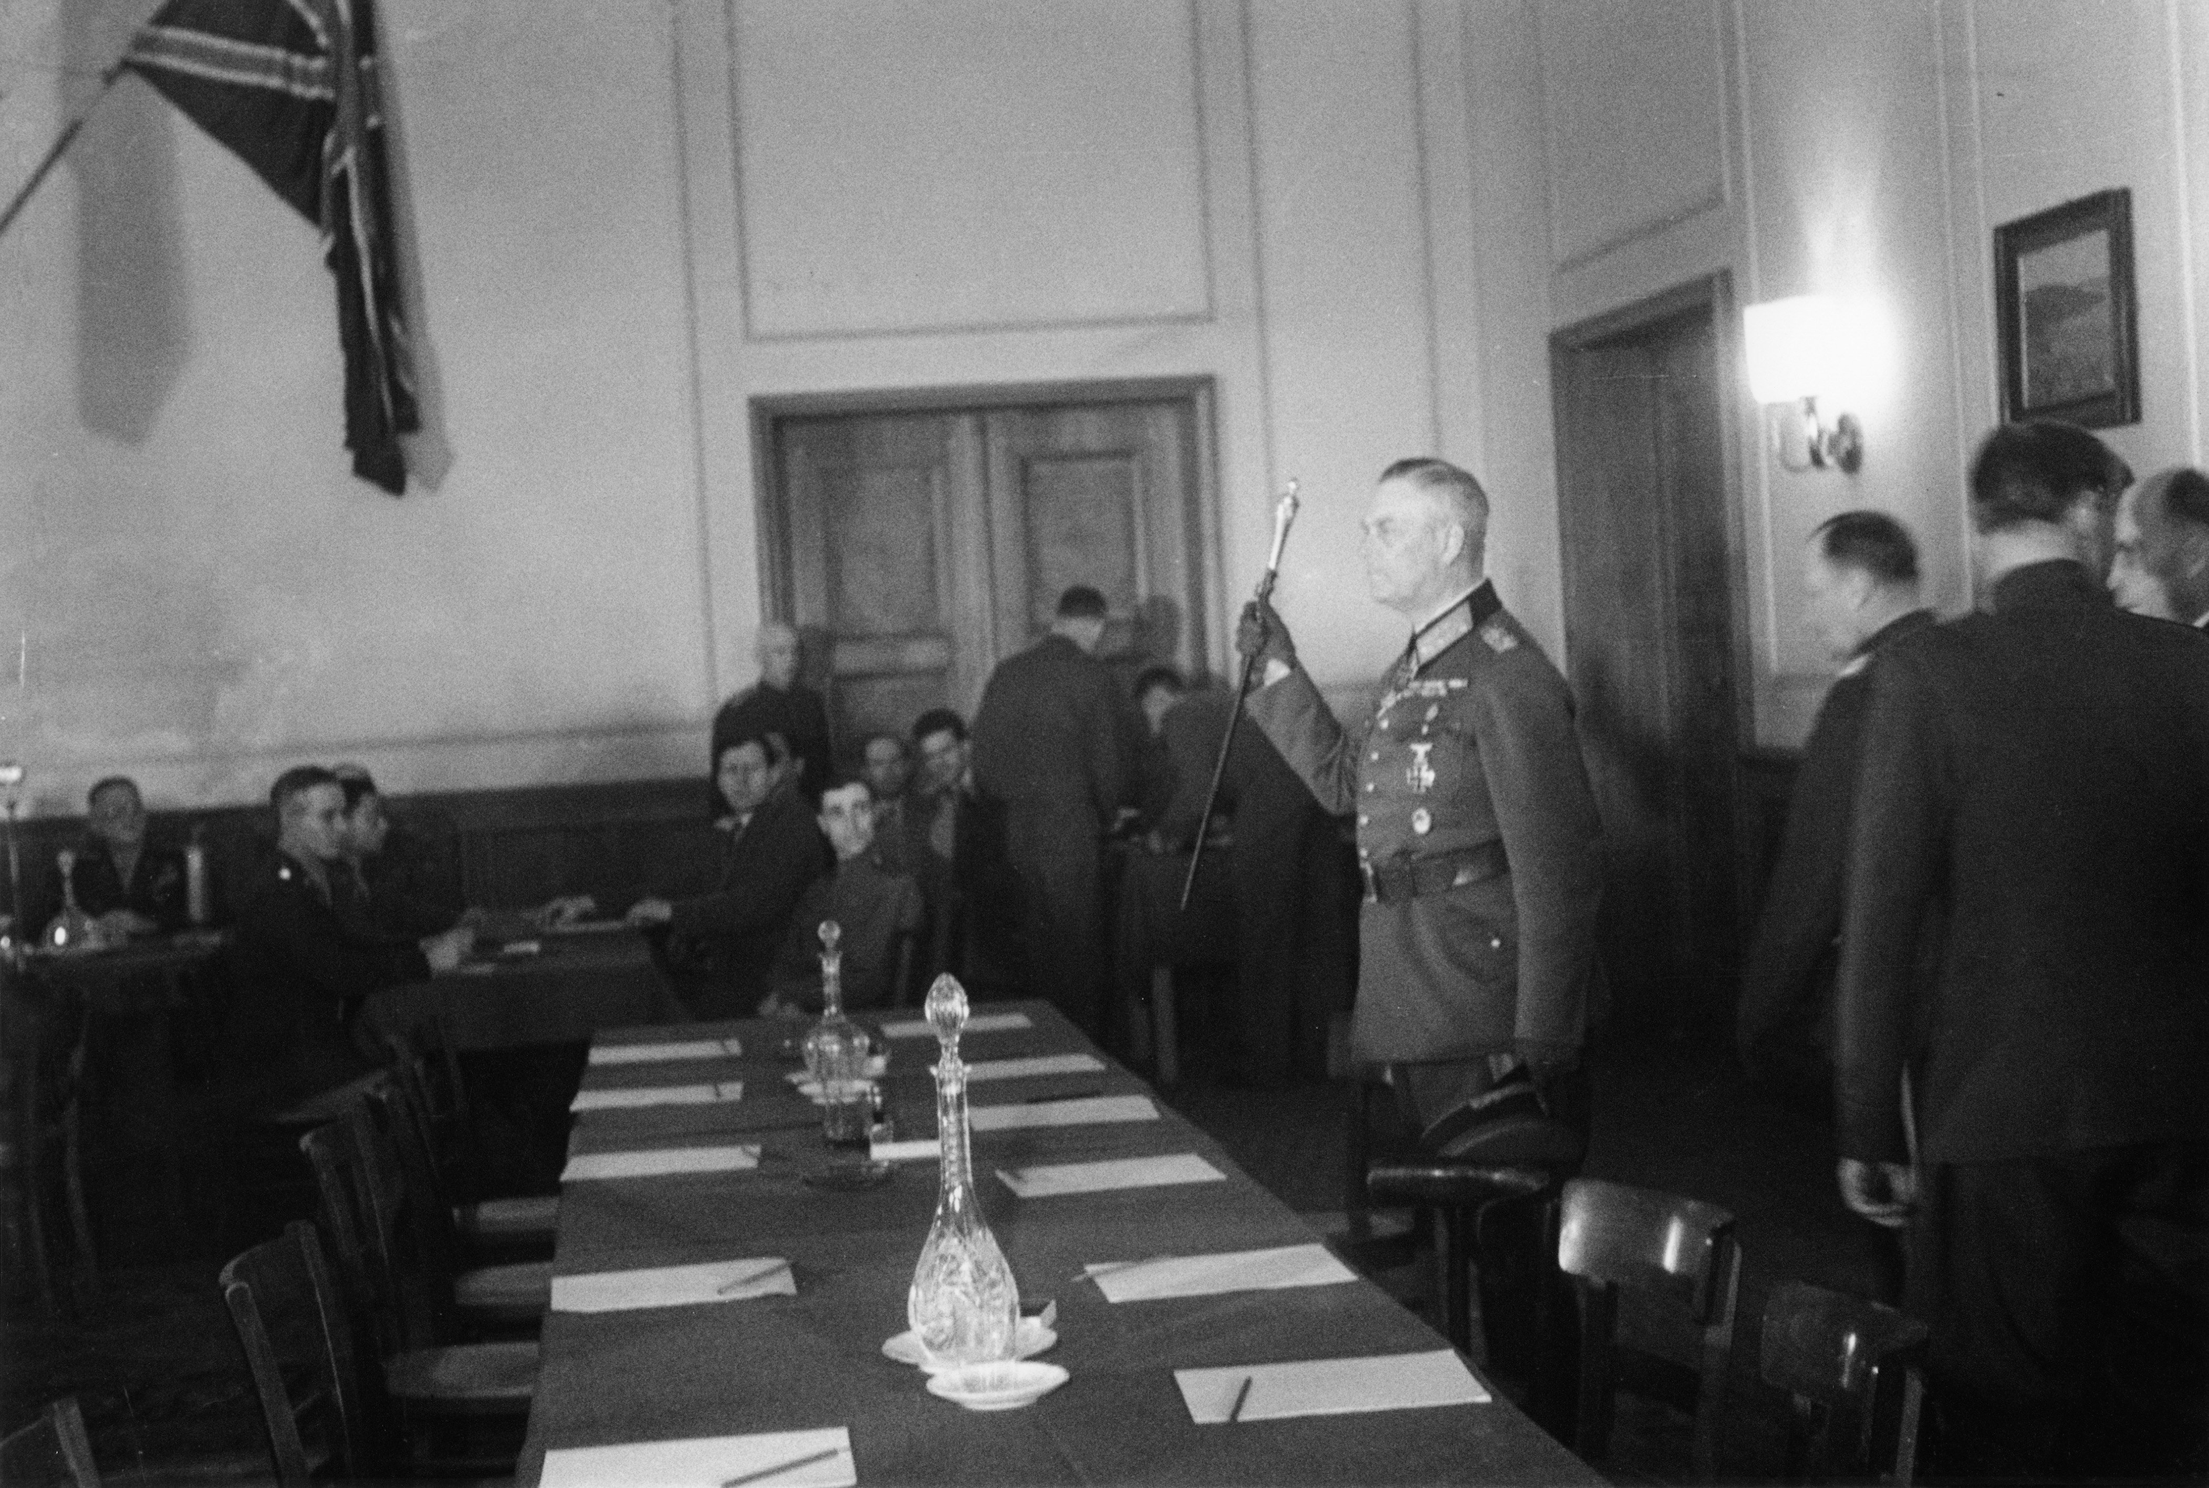
Wehrmacht signs the act of surrender in Karlshorst 8th of May 1945

Slide 9
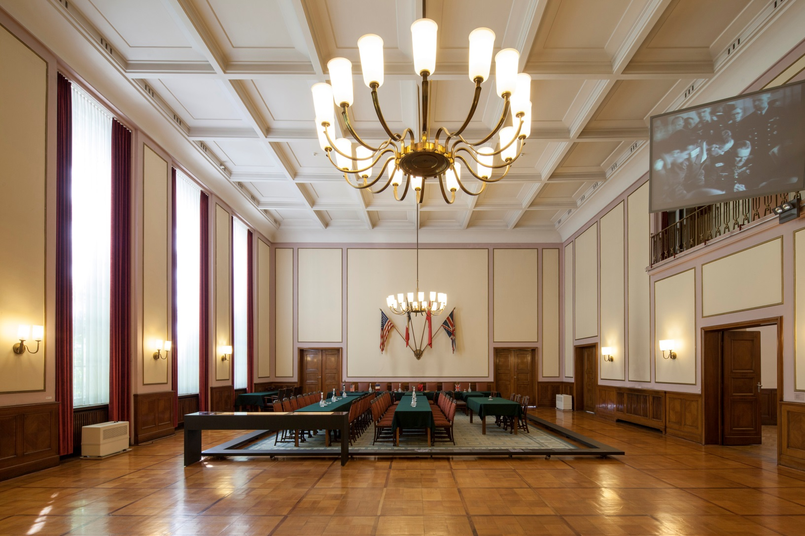
The place of surrender in 2025

Slide 10


Missed opportunity – two museums founded in 1994

Slide 11
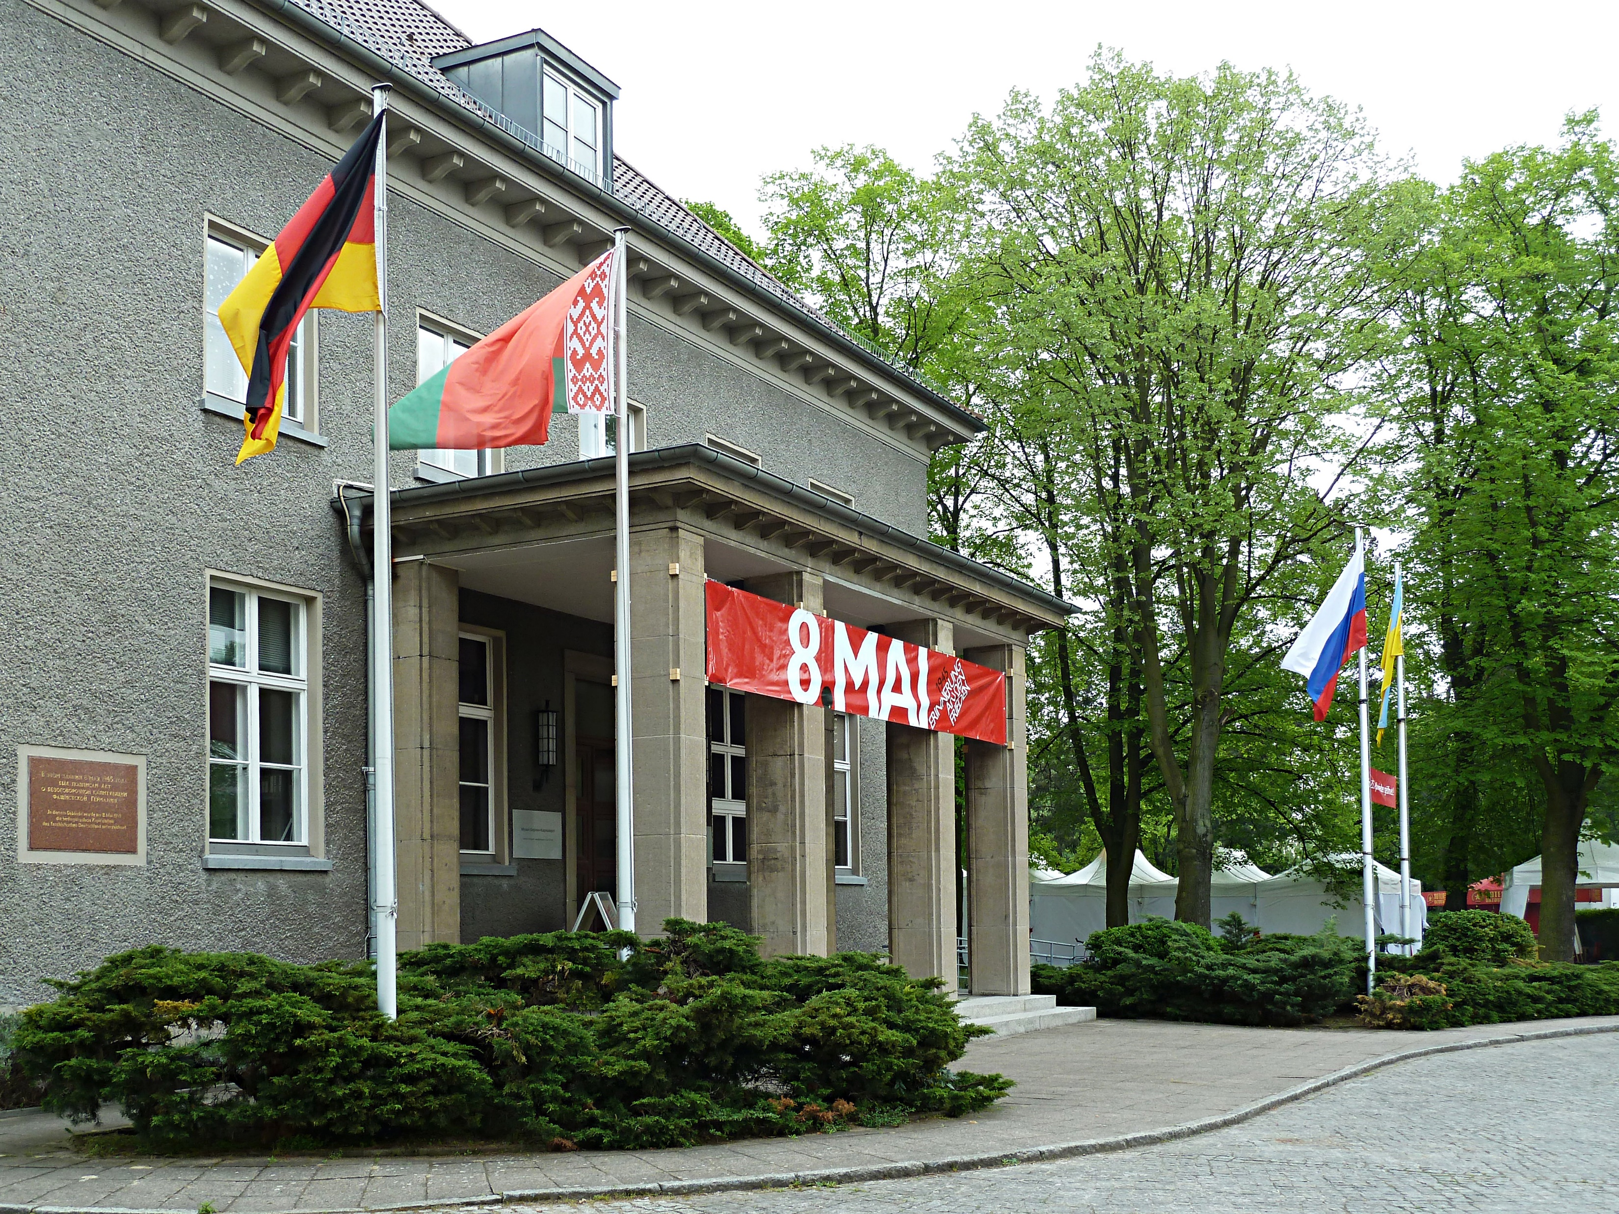
Comemorating 8th of May in the Museum (foto from 2013)

Slide 12
„History of the Museum“ and an attempt of „De-Sovietisation“

Slide 13
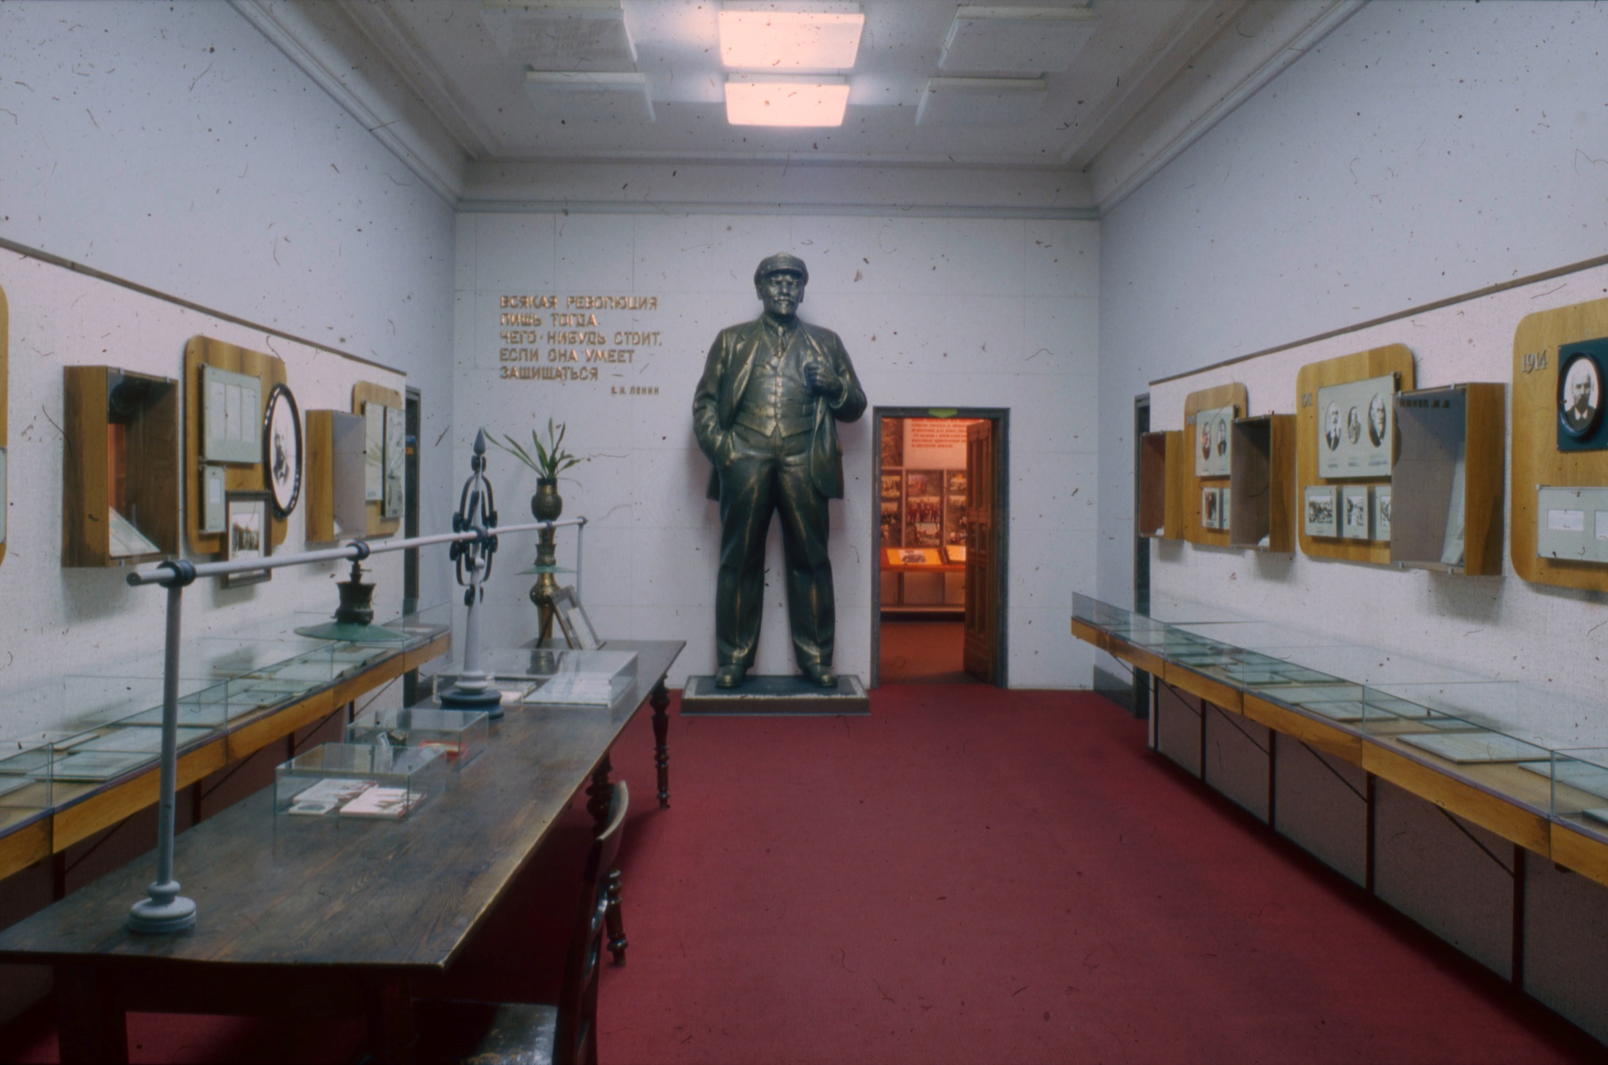
Foyer 1967 (first room of the exhibition)

Slide 14
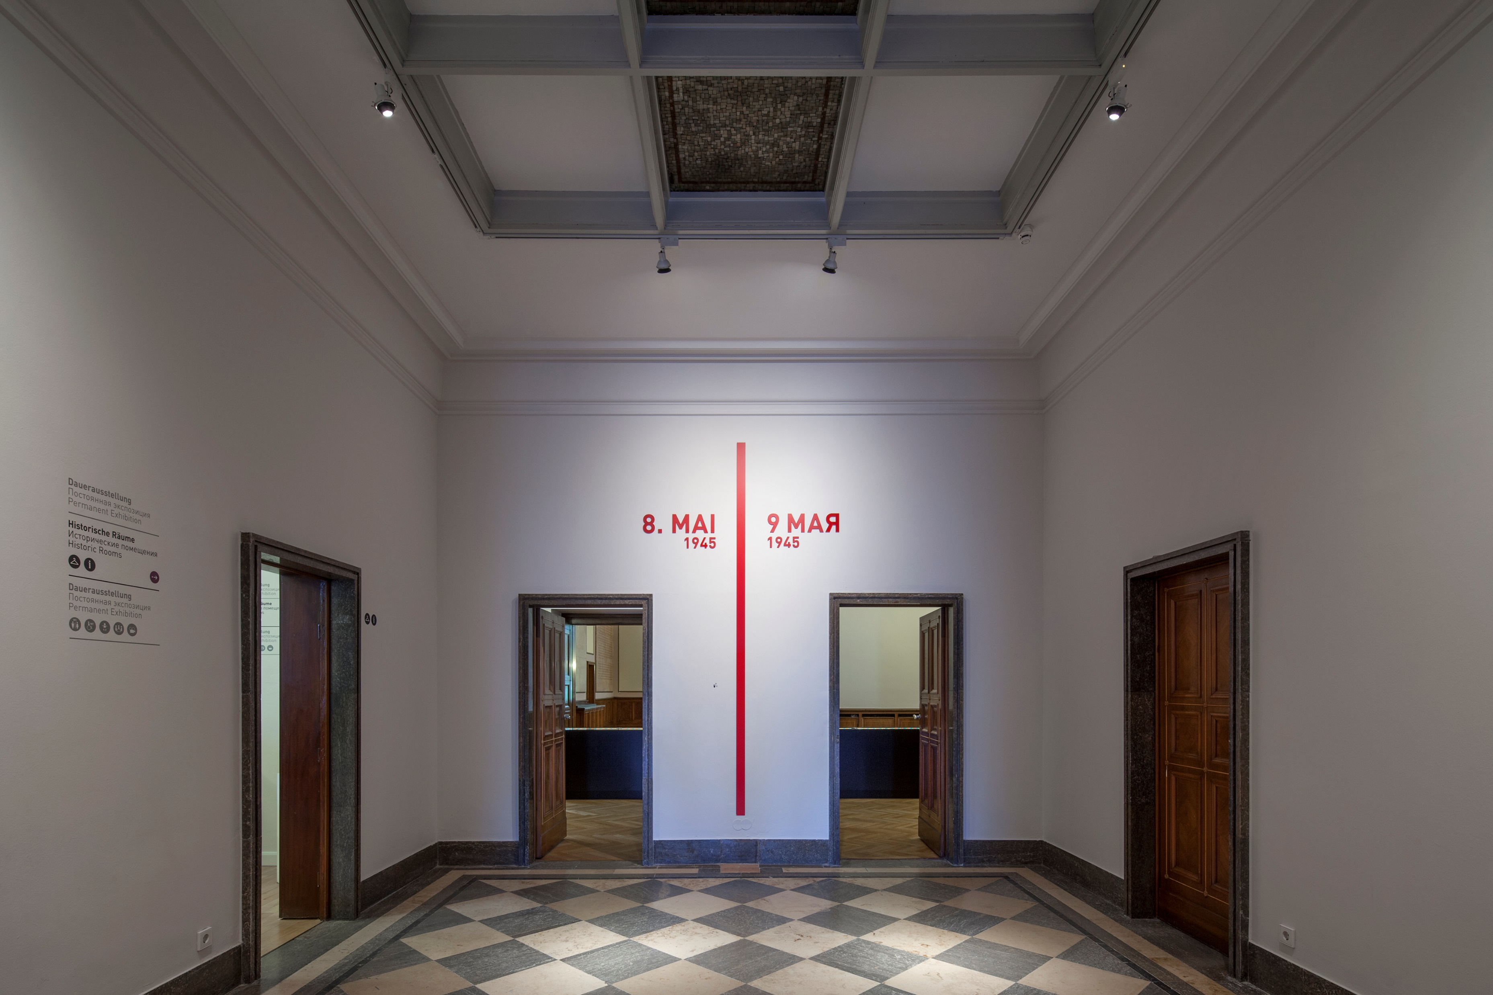
Foyer 2025

Slide 15
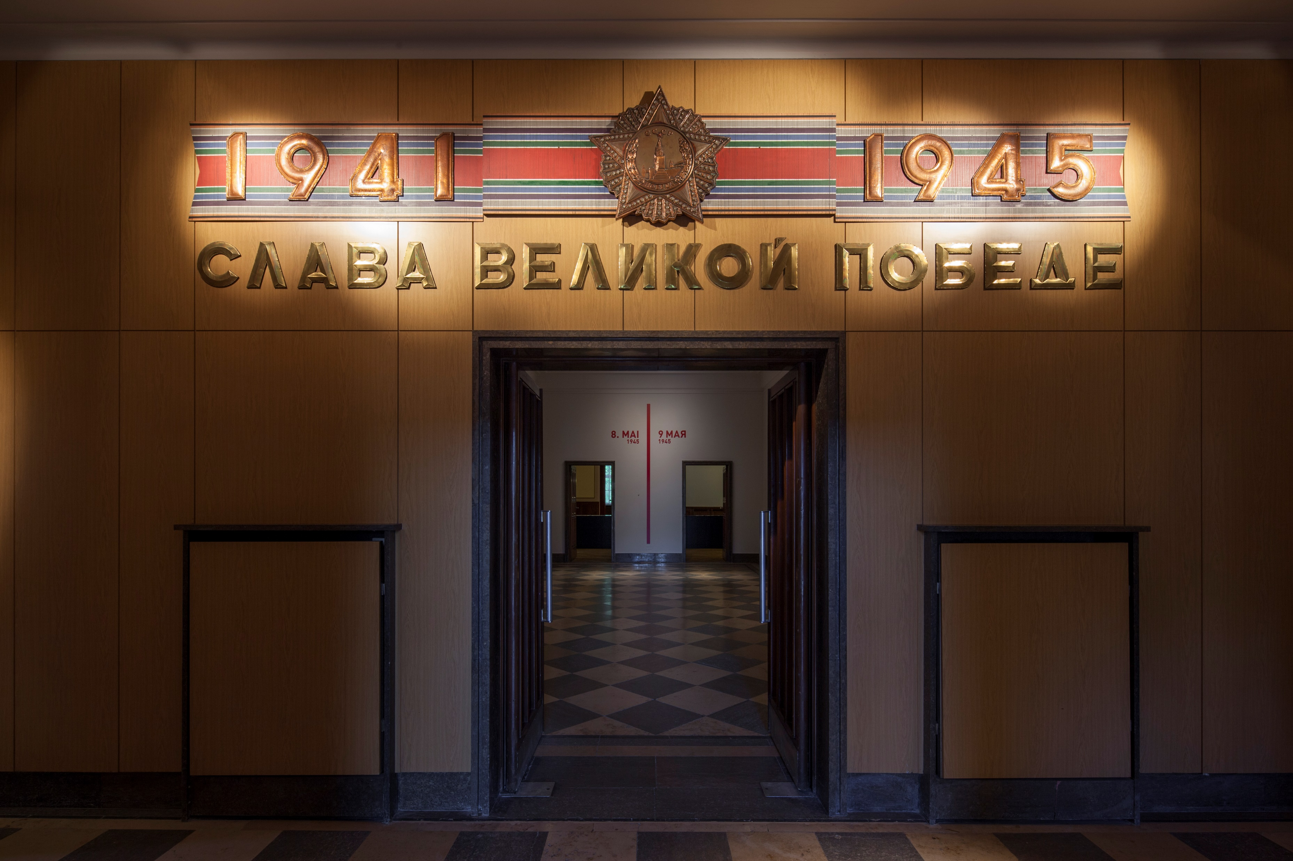
Entrance (since 1967)

Slide 16
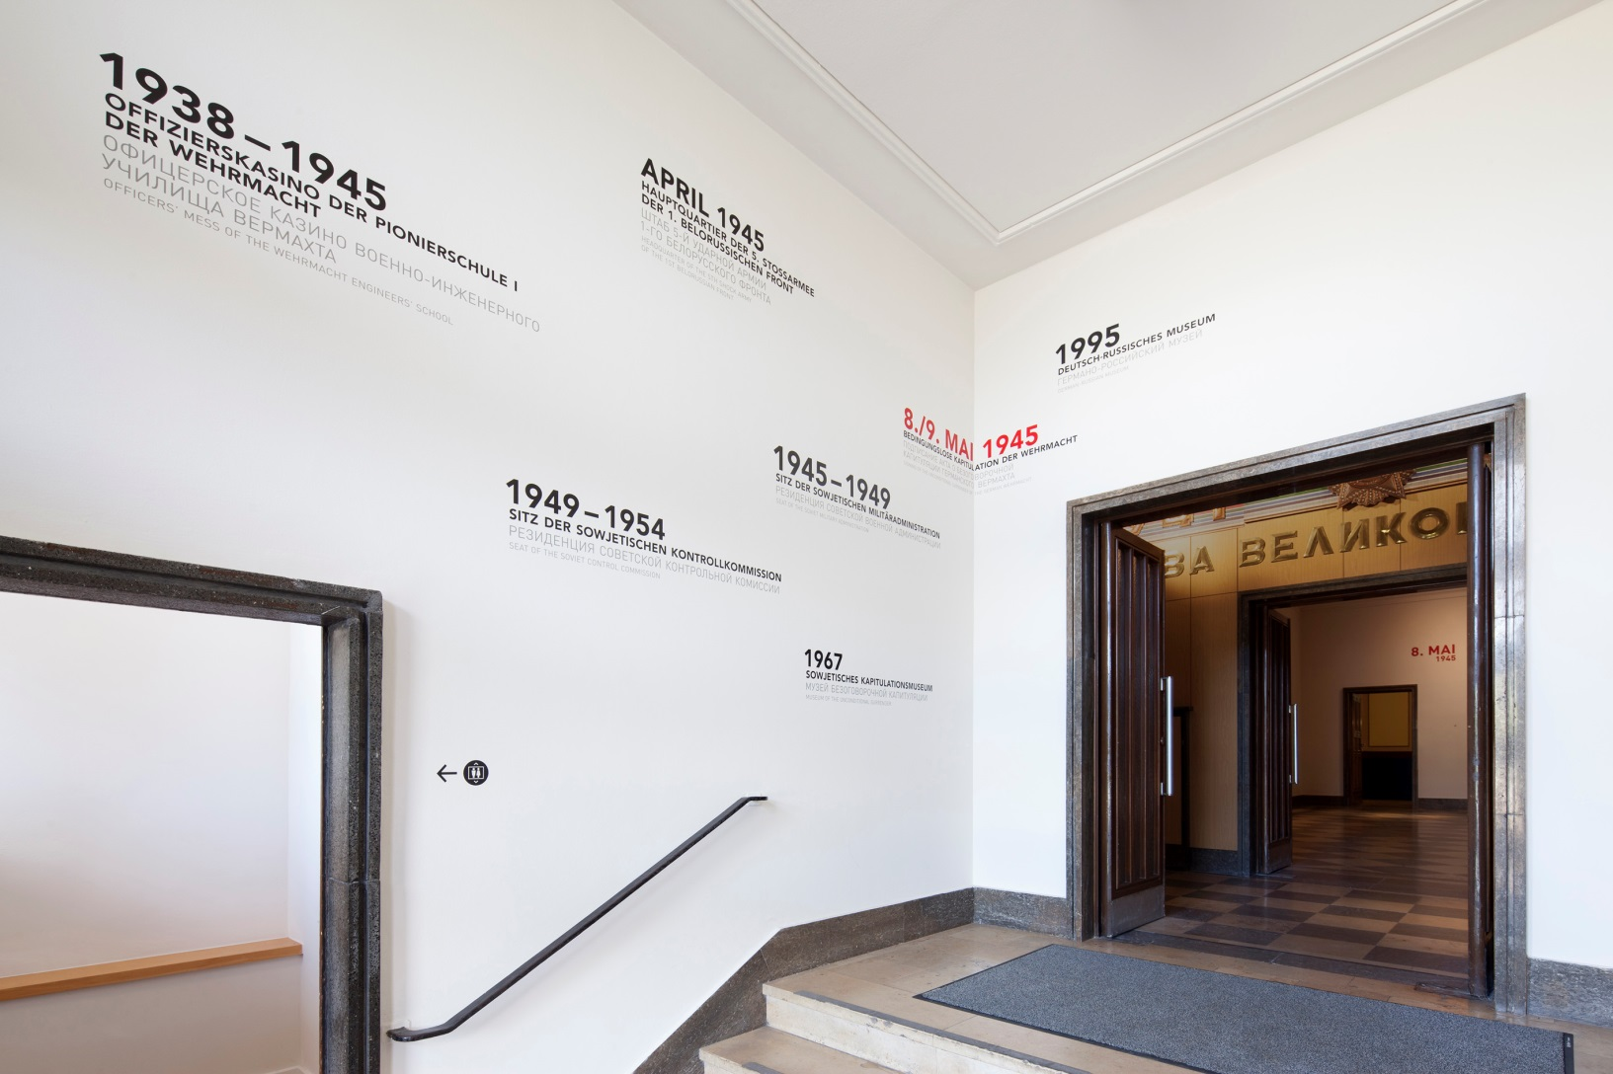
Pre-Foyer (since 2013)

Slide 17
„Pedestal Tank“
- as a powerful Soviet heritage

Slide 18
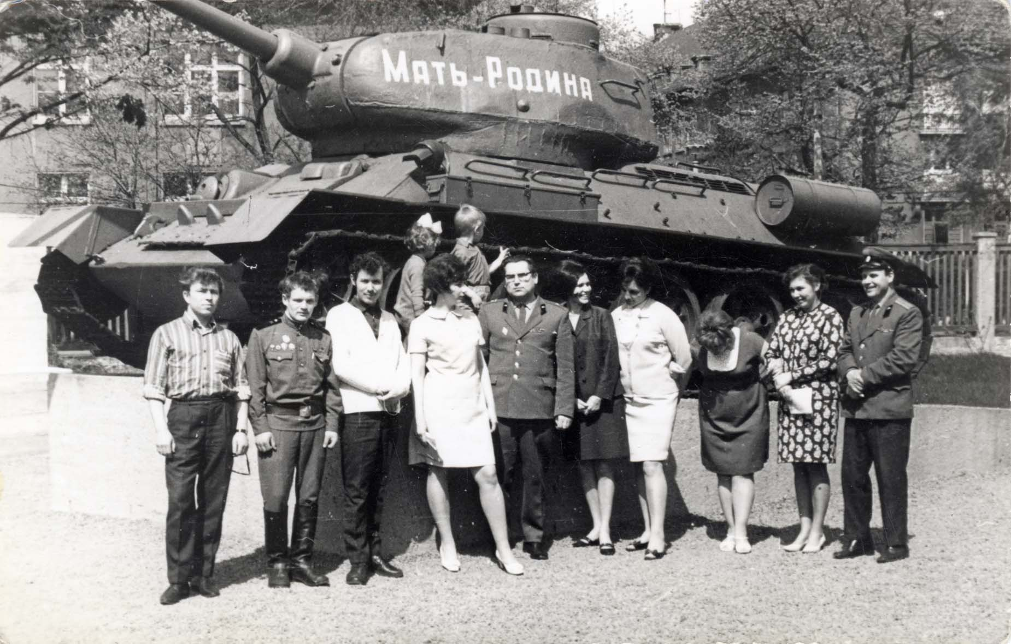
The tank in front of the Museum, 1967

Slide 19
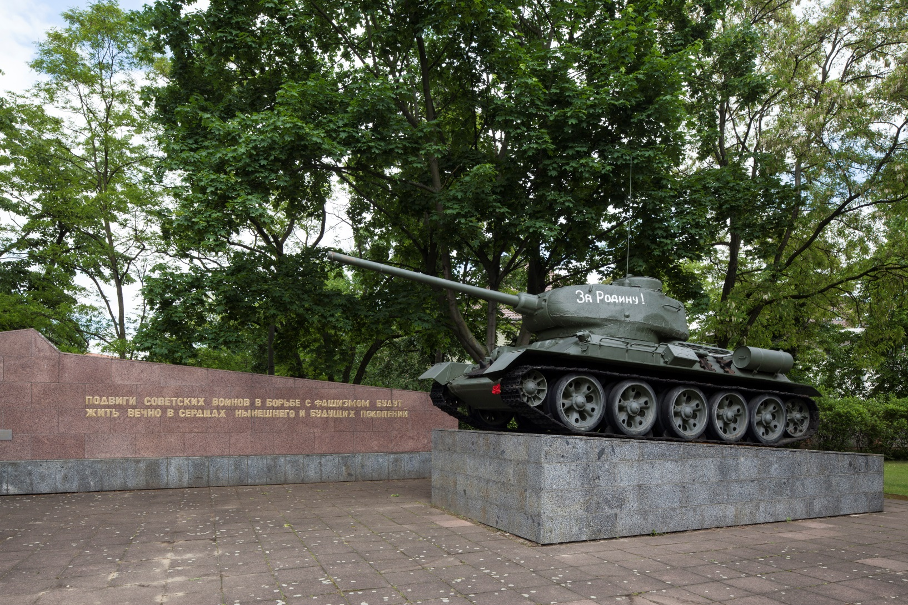
Setting in Front of the Museum since 1970ies

Slide 20
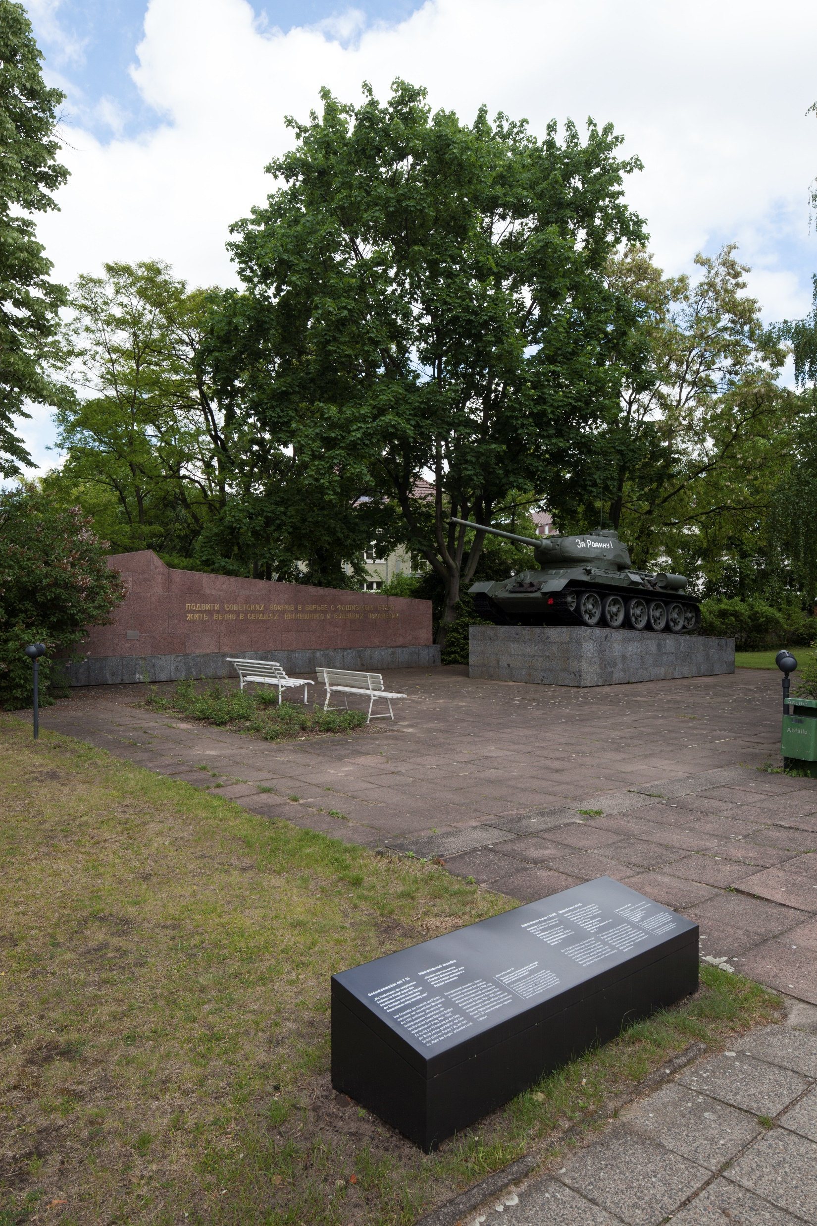
Framing the tank (since 2013)

Slide 21
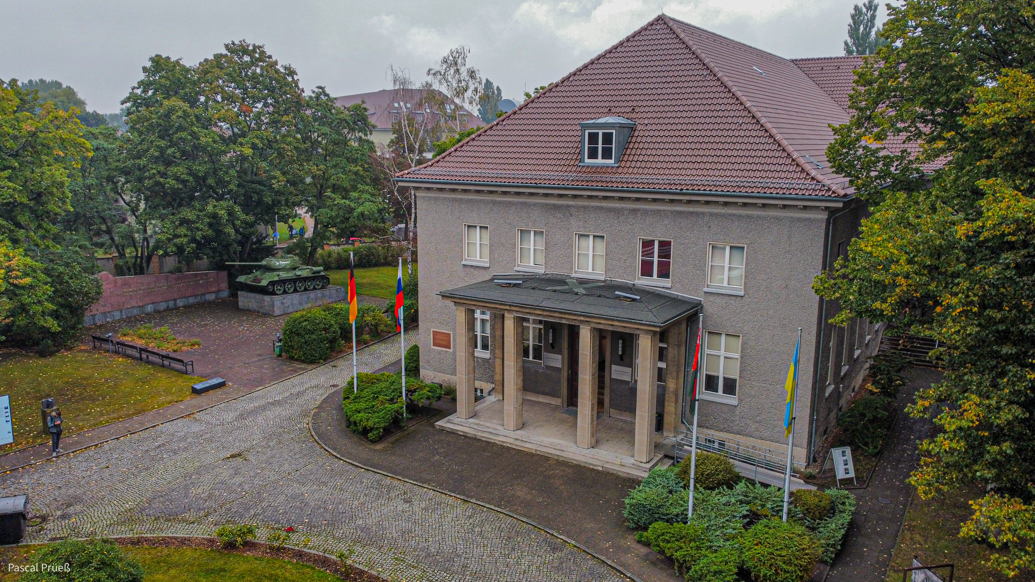
The (former) setting in front of the museum

Slide 22
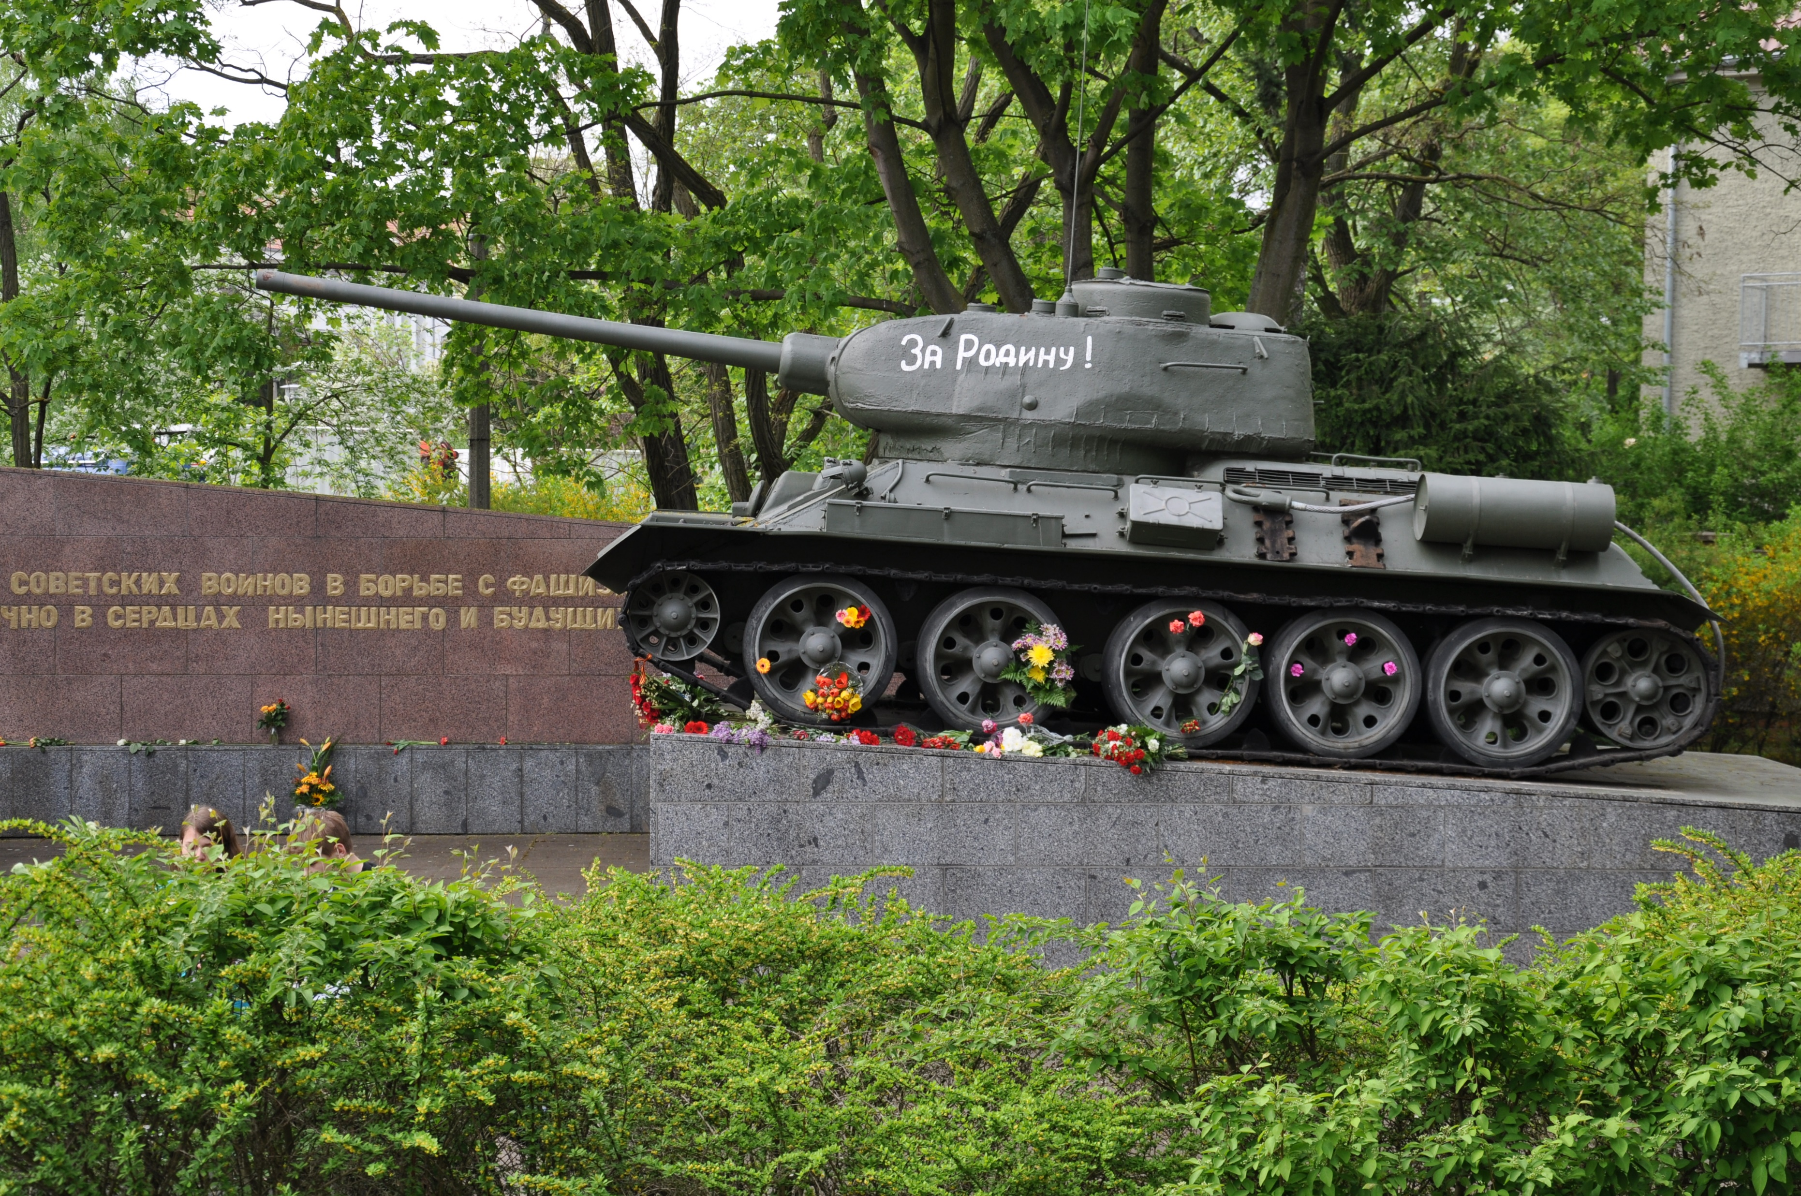
The tank on the 8th of May

Slide 23
What to do?

Slide 24
„History in Conflict“ – lectures and panel discussions since 2022

Slide 25
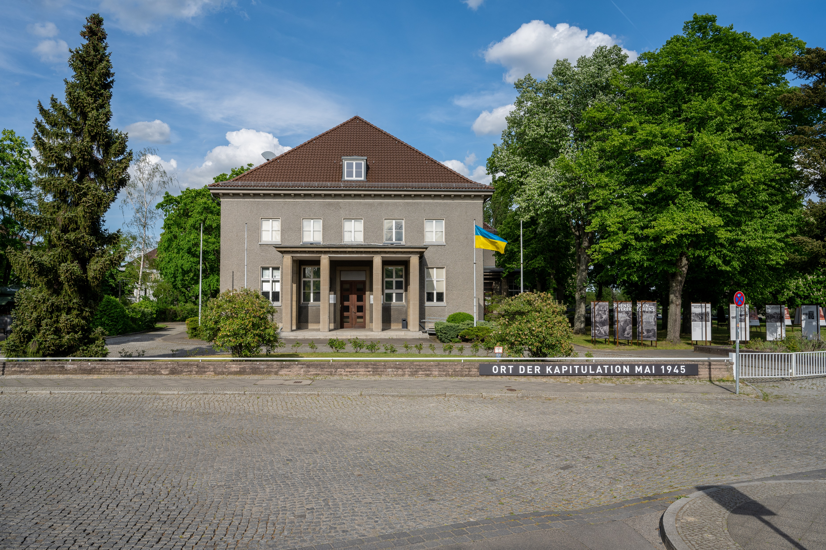
today

